Slide 1
NoSQL Databases
Pravin Y Pawar

Slide 2
NoSQL Databases
Agenda
What in NoSQL?
Types
Why NoSQL?
Pros-cons
Missing pieces
Comparing SQL and NoSQL

Slide 3
What?
Coined by Carlo Strozzi in 1998
Lightweight, open source database without standard SQL interface
Reintroduced by Johan Oskarsson in 2009
Non-relational databases
What it is ?
Open source
Non-relational
Distributed
Schema-less
Cluster Friendly
Born out of web scaled applications

Slide 4
What? (2)
Not Only SQL
Non-relational, open source, distributed databases
Supports rich variety of data : structured, semi-structured and unstructured
NoSQL
Non-relational data storage systems
No fixed table schema
No Joins
No multi-document transactions
Relaxes one or more ACID properties

Slide 5
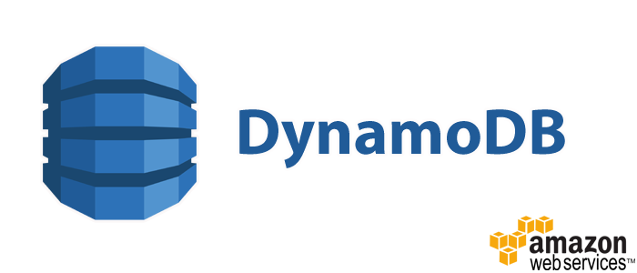



Types
Broadly classified as :
Key – value
Maintains a big hash table of keys and values
Example : Dynamo, Redis, Riak etc
Schema-less
Document
Maintains data in collections of documents
Example : MongoDB, CouchDB etc
Column
Each storage block has data from only one column
Example : Cassandra, Hbase
Graph
Network databases
Graph stores data in nodes
Example : Neo4j, HyperGraphDB

Slide 6
Why?
Scale out architecture instead of monolithic architecture of relational databases
House large amount of structured, semi-structured and unstructured data
Dynamic schemas
allows insertion of data without pre-defined schema
Auto sharding
automatically spreads data across the number of servers
applications are not aware about it
helps in data balancing and failure from recovery
Replication
Good support for replication of data which offers high availability, fault tolerance

Slide 7
Advantages
Advantages
Cheap, easy to implement
Easy to distribute
Can easily scale up and down
Relaxes the data consistency requirements
No predefined schemas
Easy support of data replication

Slide 8
Disadvantages
Lack of standardization, Support and Maturity
does not have it’s own standardized language
makes it difficult to migrate processes over to NoSQL
lack of maturity of NoSQL, as there are much less NoSQL experts than SQL at the moment
Analytics and BI
SQL has a wide array of tools for Business intelligence
However, there are not many tools for NoSQL analytics at the moment.

Slide 9
Missing Pieces
Missing
Joins
Group by
ACID properties
SQL
Easy integration with applications that support SQL

Slide 10
SQL Versus NoSQL
SQL | NoSQL
Relational database | Non relational, distributed databases
Pre-defined schema | Schema less
Table based databases | Document, column, graph based
Vertically scalable | Horizontally scalable
Not preferred for large datasets | Preferred for large datasets
Not preferred for hierarchical data | Preferred for hierarchical data
Supports ACID properties | Supports CAP theorem
Supports complex querying and data keeping needs | Does not have good support for complex querying
Excellent support from vendors | Relies heavily on community support

Slide 11

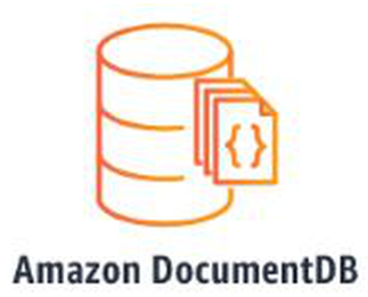



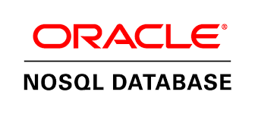
Vendors
Amazon
Facebook
Google
Oracle

Slide 12
Thank You!
Reference :
Big Data and Analytics by Seema Acharya & Subhashini Chellappan
Introduction to NoSQL Databases
https://medium.com/@mark.rethana/introduction-to-nosql-databases-c5b43f3ca1cc

